Slide 1
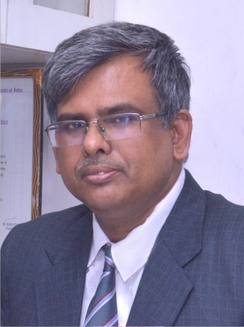
Seminar Organised by Aligarh branch of CIRC of ICAI
Topic : VIVAD SE VISHWAS SCHEME 2024 UNDER INCOME TAX
Date – 16 th NOVEMBER 2024
P. P. SINGH
LLM, LLB, FCA, CS, GSTCC, B.Sc. (H)
Contact No. +91-9711521060, 9871229590
cappsingh@gmail.com

Slide 2
P. P SINGH.
LLM, LLB, FCA, CS, GSTCC, B.Sc. (H)
Contact No. +91-9711521060, 9871229590 cappsingh@gmail.com
Post-qualification experience of around 24 years in the field of direct & indirect tax particularly income tax, GST , service tax and VAT ,sales tax .
Experience of handling the litigation matters and advisory matters of Direct taxes particularly income tax and indirect tax like GST, service tax, DVAT, CST, Central Excise and other related matters.
Authored the book DNA of GST Audit and Annual return, The DNA of TDS&TCS (including withholding tax, advance tax ) ,Background material on GST for empowerment of girl students ICAI, New Delhi
Guest faculty for certification course on GST & Certification course on appeal and representation ICAI , New Delhi;
Guest faculty for on GST CLDP Session, NIRC ICSI , New Delhi;
Visiting faculty in the National Academy Of Custom, Indirect Tax And Narcotics (known as NACIN) Saket, new Delhi.
Guest Faculty with Indian Institute of Management(IIM) MDP programme
NIFMS, Faridabad(Institute of Minister Finance),.

Slide 3
Taxes not to be imposed save by authority of law.
A- 265. No tax shall be levied or collected except by authority of law.
“The constitution of India”
Tax – compulsory financial charge imposed by government to fund public service and government functions. Essential elements of tax are compulsory payments for public purpose imposed by legislative authority, but not a fee for any specific service.
Levy/imposition/charge of tax
Collection of tax
Law – no well defined universally accepted meaning of law – various jurisprudence/legal theory has own definition – analytical school , realist theory, historical school , philosophical or ethical school , sociological school , natural law theory, pure theory of law- normative science/ hierarchy /Grundnorm, codified law/ custom & usage, legislation, delegated law/ precedent, interpretation
Authority to both levy and collection of tax under law

Slide 4
Measures to reduce tax litigations
“Para 147. While our concerted efforts to reduce pendency of appeals at various appellate fora are beginning to show good results, it will continue to engage our highest attention.
Para 148 To dispose of the backlog of first appeals, I plan to deploy more officers to hear and decide such appeals, especially those with large tax effect.
Para 149. For resolution of certain income tax disputes pending in appeal, I am also proposing Vivad Se Vishwas Scheme, 2024.
Para 150. Further, I propose to increase monetary limits for filing appeals related to direct taxes, excise and service tax in the Tax Tribunals, High Courts and Supreme Court to ₹ 60 lakh, ₹ 2 crore and ₹ 5 crore respectively.
Para 151. With a view to reduce litigation and provide certainty in international taxation, we will expand the scope of safe harbour rules and make them more attractive. We will also streamline the transfer pricing assessment procedure.” Hon'ble FM speech union budget 2024
monetary limit for filing of appeals to Tribunals, High Courts, and Supreme Courts by the tax authorities concerning direct tax, excise, and service tax has been increased to Rs. 60 Lakhs, Rs. 2 crores, and Rs. 5 Crores respectively.
DT VSVS 2024
361748 appeal pending as on 01-07-2024 before first appellate authority
Number of Appeals filed as per MIS, Age Wise, ITBA Portal:- 31.03.2018 to 25.09.2020 — 230551 24.09.2020 to 01.04.2021 –19869 01.04.2021 till today –237281
Number of Appeals disposed of:-September 2020 to 31.03.2021– 14734 01.04.2021 to 31.03.2022– 57126
source : RTI reply F. No.Pr.CCIT/NFAC/RTI/2023-24/660
dated 23-02-2024

Slide 5
DT Vivad se vishwas scheme 2024

Slide 6
History of various MST scheme introduced in India by the government
VDIS Tyagi scheme 1951
VDIS sixty-forty scheme 1965
Block voluntary disclosure scheme 1965
Amnesty circular 1985
Remittance in foreign exchange immunity scheme 1991
Voluntary disclosure of income scheme, VDIS 1997
Kar Vihar Samadhan scheme 1998
Income disclosure scheme IDS 2016
DIRECT TAX DISPUTE RESOLUTION SCHEME 2016
PRADHAN MANTRI GARIB KALYAN YOJANA, PMKGKY 2016
DIRECT TAX VIVAD SE BISHWAS SCHEME 2020
DIRECT TAX VIVAD SE BISHWAS SCHEME 2024

Slide 7
Legal Development Related to VSVS 2024
Section 88 to 99 of the finance act (no.2 - 2024)
Notification no 103/2024 Dated 19/09/2024 for appointed date of 1st October 2024 on which scheme shall come into force
Notification no 104/2024 Dated 20/09/2024 corrected by GSR 601(E) Dated 27/09/2024 notifying Direct Tax Vivad se vishwas rule 2024.
Notification no.4 of 2024 Dated 30/09/2024 for filing of declaration online for the scheme.
Notification No. 1 dated 27/09/2024 for designated authority under VSVS.
Circular no 12 of 2024 dated 15th October 2024. Guidance note 1/2024 on VSVS.
Press release Dated 21/09/2024.
No last date notify for closing date of scheme.

Slide 8
Applicability conditions
2024
Direct Tax Vivad Se Vishwas Scheme
may
It shall come into force on such date as the Central Government may, by notification in the Official Gazette, appoint.
1 Oct. 2024
Come into force from 01-10-2024 by NOTIFICATION S.O. 4016(E) [NO. 103 /2024, F.NO.370142/17/2024-TPL], DATED 19-9-2024
Section 88 of the FA (NO. 2) ACT 2024

Slide 9
WHO CAN APPROACH FOR VSVS?
APPELANT MAY OPT FOR VSVS
Meaning of appellant: "appellant" means—
(i) a person in whose case an appeal or a writ petition or special leave petition has been filed either by him or by the income-tax authority or by both, before an appellate forum and such appeal or petition is pending as on the specified date; or
(ii) a person who has filed his objections before the Dispute Resolution Panel under section 144C of the Income-tax Act and the Dispute Resolution Panel has not issued any direction on or before the specified date; or
(iii) a person in whose case the Dispute Resolution Panel has issued direction under sub-section (5) of section 144C of the Income-tax Act and the Assessing Officer has not completed the assessment under sub-section (13) of that section on or before the specified date; or
(iv) a person who has filed an application for revision under section 264 of the Income-tax Act and such application is pending as on the specified date;
Specified date means the 22nd day of July, 2024; [section 89 (1)(n)]
Writ under A-226 before HC/32 before SC
SLP-A-136
Review/curative petition before SC- A-137

Slide 10
Appeal against order U/S 263
In the context of DTVVS 2020, the CBDT clarified that if an order under Section 263 contains general directions and income is not quantifiable, an appeal against such order is not eligible under the scheme.
However, where the order under Section 263 contains specific directions and income is quantifiable, an appeal against such order is eligible for declaration and settlement under the scheme. In such a case, the assessee is required to settle all the issues in the order, which are the subject matter of the order under Section 263 and the issues pending in appeal, if any, with reference to the said order.

Slide 11
Appeal filed and pending on 22-07-2024
Appeal filed with application for condonation of delay but yet to be admitted on specified date –scheme could be opted.
Appeal admitted and pending on specified date- scheme could be opted.
An appeal would be 'pending' in the context of Section 2(1)(a) of DTVVS 2020 (corresponding to Section 89(1)(a) of DTVVS 2024) when it is first filed till its disposal [Shyam Sunder Sethi v. Pr. CIT [2021] 130 taxmann.com 66 (Delhi)].
Meaning of appeal pending : In Raja Kulkarni v. State of Bombay AIR 1954 SC 73, the Apex Court held that from the mere fact that an appeal is held to be not maintainable on any ground whatsoever, it does not follow that there was no appeal pending before the Court.
In Mela Ram & Sons. v. CIT [1956] 29 ITR 607, SC held that it is not correct to say that "an appeal which is filed beyond the period of limitation is in the eye of law, no appeal, unless and until there is a condonation of delay".
The ratio of the above decisions of the Supreme Court are relevant for the Scheme as the words used in Section 89(1)
(a) are 'filed and pending' and not the words 'admitted and pending’ as used in the Kar Vivad Samadhan Scheme, 1998
[See also Shree Amarlal Kirana Stores v. Commissioner of Income-tax [2003] 126 Taxman 512 (MP), where the Court
explained the distinction between 'admitted and pending' used in KVSS and simply 'pending'].

Slide 12
Repetitive appeals- application u/s 158A/158AA- scheme available for all the years.
In this regard, in the context of DTVVS 2020, where the specified date was 31-01-2020, the CBDT clarified that a
declaration/application filed under Section 158A/158AA on or before 22-07-2024 shall be deemed to be a pending
appeal for the purposes of the Scheme.

Slide 13
There is no bar on the declaration by someone who had earlier availed the benefit of the Kar Vivad Samadhan Scheme,1998, the Direct Tax Dispute Resolution Scheme, 2016 or the Direct Taxes Vivad Se Vishwas Act, 2020.only requirement is appeal /writ/SLP must be file and pending on 22/07/ 2024.
Can a taxpayer opt for this scheme if he has opted for a similar scheme announced in earlier years?

Slide 14
Meaning of dispute- Rule 2(1) (b)
Dispute' means:
(a) An appeal, writ or special leave petition filed by the declarant or the income-tax authority before the Appellate Forum [CIT(A)/ITAT/HC/SC]
(b) Objections filed before the DRP under Section 144C of the IT Act and the Dispute Resolution Panel has not issued any direction,
(c) DRP has issued the direction under Section 144C(5), and the AO has not completed the assessment under Section 144C(13), or
(d) Revision application filed under Section 264 of the IT Act.
Review under article 137 not covered

Slide 15
Can DA (Designated Authority) reject assessee declaration?
The designated authority cannot sit in judgment on the strength/merits of appeals. The merits or the strength of the case is irrelevant. As long as the dispute is pending as of the specified date, it has to be regarded by the DA as a pending dispute eligible for declaration and settlement by the taxpayer under the Scheme.
Example : Employee contribution to provident fund, ESI Paid by the employer after due date under respective Act disallowed as decided in the case of checkmate services Pvt Ltd by apex court and appeal is pending on such issue. Even in such cases DA can not reject declaration.

Slide 16
Amount payable by declarant – section 90

Slide 17
sl. No. | Nature of tax arrear. |  | Amount payable under this Scheme on or before the 31st day of December, 2024. |  | Amount payable under this Scheme on or after the 1st day of January, 2025 but on or before the last date.
(1) | (2) |  | (3) |  | (4)
(a) | Where the tax arrear is the aggregate amount of disputed tax, interest chargeable or charged on such disputed tax and penalty leviable or levied on such disputed tax in a case where the declarant is an appellant after the 31st day of January, 2020 but on or before the specified date( 22-07-2024). |  | 100% of disputed tax. |  | 110% of disputed tax.
(b) | Where the tax arrear is the aggregate amount of disputed tax, interest chargeable or charged on such disputed tax and penalty leviable or levied on such disputed tax in a case where the declarant is an appellant on or before the 31st day of January, 2020 at the same appellate forum in respect of the such tax arrear. |  | 110% of disputed tax. |  | 120% of disputed tax.
(c) | Where the tax arrear relates to disputed interest or disputed penalty or disputed fee where the declarant is an appellant after the 31st day of January, 2020 but on or before the specified date. |  | 25% of disputed interest or disputed penalty or disputed fee. |  | 30% of disputed interest or disputed penalty or disputed fee.
(d) | Where the tax arrear relates to disputed interest or disputed penalty or disputed fee where the declarant is an appellant on or before the 31st day of January, 2020 at the same appellate forum in respect of the such tax arrear. |  | 30% of disputed interest or disputed penalty or disputed fee. |  | 35% of disputed interest or disputed penalty or disputed fee:

Slide 18
Appeal by department is pending: Provided that in a case where an appeal or writ petition or special leave petition is filed by the income-tax authority on any disputed issue before the appellate forum, the amount payable shall be one-half of the amount in the Table above calculated on such issue, in such manner, as may be prescribed:
Favourable order by higher appellate forum: Provided further that in a case where an appeal is filed before the Commissioner (Appeals) or Joint Commissioner (Appeals) or objections is filed before the Dispute Resolution Panel by the appellant on any issue on which he has already got a decision in his favour from the Income-tax Appellate Tribunal (where the decision on such issue is not reversed by the High Court or the Supreme Court) or the High Court (where the decision on such issue is not reversed by the Supreme Court), the amount payable shall be one-half of the amount in the Table above calculated on such issue, in such manner, as may be prescribed:
Provided also that in a case where an appeal is filed by the appellant on any issue before the Income-tax Appellate Tribunal on which he has already got a decision in his favour from the High Court (where the decision on such issue is not reversed by the Supreme Court), the amount payable shall be one-half of the amount in the Table above calculated on such issue, in such manner as may be prescribed.

Slide 19
Section 89(1)(j) Disputed tax", in relation to an assessment year or financial year, as the case may be, means the income-tax including surcharge and cess (hereafter in this Chapter referred to as the amount of tax) payable by the appellant under the provisions of the Income-tax Act, as computed hereunder:—
(A) in a case where any appeal, writ petition or special leave petition is pending before the appellate forum as on the specified date, the amount of tax that is payable by the appellant if such appeal or writ petition or special leave petition was to be decided against him;
(B) in a case where objection filed by the appellant is pending before the Dispute Resolution Panel under section 144C of the Income-tax Act, as on the specified date, the amount of tax payable by the appellant if the Dispute Resolution Panel was to confirm the variation proposed in the draft order;
(C )in a case where Dispute Resolution Panel has issued any direction under sub-section (5) of section 144C of the Income-tax Act, and the Assessing Officer has not completed the assessment under sub-section (13) of that section on or before the specified date, the amount of tax payable by the appellant as per the assessment order to be passed by the Assessing Officer in pursuance of the said assessment under sub-section (13) thereof;
(D) in a case where an application for revision under section 264 of the Income-tax Act, is pending as on the specified date, the amount of tax payable by the appellant if such application for revision was not to be accepted:

Slide 20
Where dispute is related to reduction in tax credit- Sec 89(1)(j) read with rule 9
Provided that in a case where the dispute in relation to an assessment year relates to reduction of tax credit under section 115JAA or section 115JD of the Income-tax Act, or any loss or depreciation computed thereunder, the appellant shall have an option
either to include the amount of tax related to such tax credit or loss or depreciation in the amount of disputed tax. or
to carry forward the reduced tax credit or loss or depreciation, in such manner as may be prescribed.;
In first option assessee have to pay tax, cess, surcharge and carry forward the original figure of unabsorbed depreciation/tax credit.
In second option WDV cannot be enhanced where unabsorbed depreciation reduced
Further assessee has to pay tax, cess, surcharge, interest

Slide 21
Meaning of Tax Arrear – Sec89(1)(o)
Tax arrears" means:
(a) the aggregate amount of disputed tax, interest chargeable or charged on such disputed tax, and penalty leviable or levied on such disputed tax; or
(b) disputed interest; or
(c) disputed penalty; or
(d) disputed fee.

Slide 22
Meaning of Disputed Interest- Sec 89(1)(h)
"disputed interest" means the interest determined in any case under the provisions of the Income-tax Act, where—
(a) such interest is not charged or chargeable on disputed tax;
(b) an appeal has been filed by the appellant in respect of such interest

Slide 23
Meaning of Disputed Penalty- Sec 89(1)(j)
"disputed penalty" means the penalty determined in any case under the provisions of the Income-tax Act, where—
(a) such penalty is not levied or leviable in respect of disputed income or disputed tax, as the case may be;
(b) an appeal has been filed by the appellant in respect of such penalty.

Slide 24
Procedure and forms under the scheme 2024
Form- 1: Form for filing declaration and undertaking by the declarant
Form-2 : Form for Certificate to be issued by Designated Authority
Form-3 : Form for intimation of payment by the declarant
Form-4 : Order for Full and Final Settlement of tax arrears by Designated Authority
The Scheme also provides that Form-1 shall be filed separately for each dispute, provided that where appellant and the income-tax authority, both have filed an appeal in respect of the same order, single Form-1 shall be filed in such a case.
The intimation of payment is to be made in Form-3 and is to be furnished to the Designated Authority along with proof of withdrawal of appeal, objection, application, writ petition, special leave petition or claim.

Slide 25
Revised Declaration
Although there is no specific provision for revised declaration but in the context of DTVVS 2020, the CBDT clarified that the declaration made can be revised any number of times before the DA issues a certificate.
Portal has facility for revised declaration form .
The above view is supported by the decision in Value Added Futuristic Management (P.) Ltd. v. Union of India [2022] 143 taxmann.com 428/[2023] 290 Taxman 285/[2022] 447 ITR 48 (Jharkhand) wherein it was held that there is no provision in the scheme that further envisages filing of revised/fresh declaration after the declaration has been accepted by the designated authority.

Slide 26
Time and manner of payment.
SECTION 92
(1) The designated authority(DA) shall, within a period of 15 days from the date of receipt of the declaration, by order, determine the amount payable by the declarant in accordance with the provisions of this Scheme and grant a certificate to the declarant form 2 containing particulars of the tax arrear and the amount payable after such determination, in such form as may be prescribed.
(2) The declarant shall pay the amount determined under sub-section (1) within a period of 15 days of the date of receipt of the certificate and intimate the details of such payment to the designated authority in the prescribed form (in form 3 ) and thereupon the designated authority shall pass an order ( in form 4) stating that the declarant has paid the amount.
(3) Every order passed under sub-section (1), determining the amount payable under this Scheme, shall be conclusive as to the matters stated therein and no matter covered by such order shall be reopened in any other proceeding under the Income-tax Act or under any other law for the time being in force.
(4) Making a declaration under this Scheme shall not amount to conceding the tax position and it shall not be lawful for the income-tax authority or the declarant being a party in appeal or writ petition or special leave petition to contend that the declarant or the income-tax authority, as the case may be, has acquiesced in the decision on the disputed issue by settling the dispute.

Slide 27
Delay in part payments after filing declaration due to fault of tax officials or portal issue
The Bombay High Court at Goa has directed the department to accept the declaration under the Vivad Se Vishwas Act, 2020 (VsV Act).The bench of Justice M. S. Sonak and Justice Valmiki Sa Menezes has observed that the delay alleged on the part of the Petitioner is hardly 11 days. W.P 600 of 2023 pronounced on 22-01-2024 in the writ of Mrs. Neelam ajit phatarpekar Vs ACIT MUM HC

Slide 28
cases not covered under VSVS Scheme 2024? Section 96
(i) relating an assessment year in respect of which an assessment has been made under section 143(3)/ 144/147/153A/153C of the Act on the basis of search initiated under section 132/132A of the Act;
(ii) relating to an assessment year in respect of which prosecution has been instituted on or before the date of filing of declaration;
(iii) relating to any undisclosed income from a source located outside India or undisclosed asset located outside India;
(iv) relating to an assessment or reassessment made on the basis of information received under an agreement referred to in section 90 or section 90A of the Act, if it relates to any tax arrear.
There are certain other cases of excluded list are:
Where order of detention under provisions of COFEPOSA Act, 1974;
Where prosecution under Unlawful Activities (Prevention) Act, 1967; NDPS Act 1985 Prohibition of benamies Properties Act, 1988; Prevention of Corruption Act, 1988; PMLA 2002 etc.
Prosecution initiated by income tax for offence punishable under Bhartiya Nayay Sanghita or any civil laiblities

Slide 29
Bar on declaration apply to that assessment year only for which prosecution has been instituted?
In terms of Section 96(a)(ii) of the scheme, the provisions of this scheme shall not apply in respect of tax arrears relating to an assessment year in respect of which prosecution has been instituted on or before the date of filing of declaration.
Sub-clause (ii) uses the words "an assessment year in respect of which prosecution has been instituted on or before the date of filing of declaration". Thus, an assessee becomes ineligible to make a declaration of tax arrears for that assessment year in respect of which the Income tax department instituted the prosecution on or before the date of filing the declaration.
It should be noted that the mere issue of notice for prosecution does not amount to the prosecution being instituted and would not bar the assessee from making a declaration. Further, the assessee can declare even if prosecution has been instituted if prosecution is compounded before filing the declaration.

Slide 30
Bar on declaration if prosecution has been instituted?
It should be noted that the mere issue of notice for prosecution does not amount to the prosecution being instituted and would not be a bar for the assessee from making a declaration.
Further, the assessee can declare even if prosecution has been instituted but prosecution is compounded on payment of compounding fees before filing the declaration .

Slide 31
Search assessments - no VSVS
(i) Where a search is initiated under section 132 or books of account, other documents or any assets are requisitioned under section 132A, on or after the 1st day of April, 2021, in the case of the assessee and assessments have been made consequently; or
(ii) Where the Assessing Officer has drawn satisfaction, with the prior approval of the Principal Commissioner or Commissioner, that any money, bullion, jewellery or other valuable article or thing, seized or requisitioned under section 132 or section 132A in case of any other person on or after the 1st day of April, 2021, belongs to the assessee and assessments have been made consequently; or
(iii) Where the Assessing Officer has drawn satisfaction, with the prior approval of Principal Commissioner or Commissioner, that any books of account or documents, seized or requisitioned under section 132 or section 132A in case of any other person on or after the 1st day of April, 2021, pertains or pertain to, or any information contained therein, relate to the assessee and assessments have been made consequently.
Assessments shall be considered to have been made on the basis of search initiated under section 132/132A of the Act?

Slide 32
Appeal disposed off
The DTVSV Scheme, 2024 is a Scheme for settlement of tax disputes. Where a decision has been given prior to the taxpayer filing declaration , there is no dispute pending unless the taxpayer or the Department again prefers an appeal. Therefore where an appeal is pending as 22.7.2024 but is not pending as on the date of making declaration under the Scheme, such cases shall not be eligible for the Scheme.
However, in cases where a taxpayer files declaration under the Scheme and intimates the same to the appellate authority, the concerned appellate authority may consider not disposing Appeal of the taxpayer.
Suppose a taxpayer is eligible to apply for DTVSV Scheme, 2024 as his appeal is pending as on 22.7.2024. But subsequently, before the taxpayer could file declaration under the DTVSV Scheme, 2024, his appeal has been disposed off. Can such a taxpayer still file declaration under the Scheme?
In the clarification issue under 2020 scheme CBDT has clarified that in such cases assessee is eligible for declaration for settlement under the scheme.

Slide 33
Time limit to file appeal not expired on 22.7.24
Q.9
As per section 89(1) of the Scheme, it is clear that the appeal has to be pending as on the specified date i.e. 22.07.2024 for an appellant to be eligible for the Scheme. The definition of appellant also covers cases where the DRP has issued directions u/s 144C(5) but the AO has not completed the assessment u/s 144C( 13).
Therefore, the Scheme does not provide for eligibility of those the Scheme? cases where an appeal is not pending as on 22.7.2024 except for DRP cases referred above.

Slide 34
Application pending with AAR
If AAR has not passed any order there is no dispute pending.
If AAR has passed order determining total income and against that writ is pending before High Court on specified date- Scheme is available
If AAR has passed order which has not determined total income such as determination of PE in india there is no disputed tax – No Scheme available.

Slide 35
Settling issues in part
As per section 91(2), of the scheme after filing declaration appeal before ITAT,CIT (appeal), JCIT (appeal) are deemed to be withdrawn from the date of issue of certificate by the designated authority. Further, as per section 91(3) of the scheme the taxpayer is required to withdraw appeal and furnish proof thereof along with intimation of payment under section 92(2),of the scheme. Therefore the scheme does not envisaged settling issue in part. The dispute has to be settle in full as per the scheme. Thus where there are non qualifying tax dispute are not eligible to be covered under the scheme.
Where disputed tax contents qualifying tax arrear along with non-qualifying tax arrear such as tax arrear mention in section 96( a) for example, tax area in respect of undisclosed foreign income whether taxpayer can apply for the scheme in such a case?

Slide 36
Settling penalty appeal while quantum appeal is pending
There is definition of disputed penalty under section 89(1)(i). It provides that disputed penalty is such penalty is such penalty which is not Levied or leviable in respect of disputed income or dispute tax. thus it would not be possible for the appellant to apply for settlement of penalty appeal only where quantum appeal on disputed tax related to such penalty is still pending.
if both quantum appeal covering demand of disputed tax and appeal against penalty levied on such disputed tax for any assessment are pending. The declarant is required to file a declaration form giving details about disputed tax and penalty appeal. However, he would be required to pay relevant percentage of disputed tax only.
Can a taxpayer settle a penalty appeal while continuing to litigate the associated quantum appeal?

Slide 37
Protective and substantial addition
Where substantive as well as protective addition have been made whether in case of same taxpayer for different assessment years or in the hand of different taxpayer, then either of the two additions i.e. substantive or protective additions could be settled if the substantive is eligible for settlement under the scheme.
On the settlement of disputes related to substantive or protective additions, Ao shall pass rectification order, deleting the protective or substantive addition as the case may be, relating to the same issue in case of same taxpayer or in the case of another taxpayer.
There may be a case of substantive addition as well as protective addition in the case of same assessee for different assessment years or there may be situations where substantive addition in the case of one assessee and protective assessment in the case of another assessee.

Slide 38
Dispute related to other direct taxes, such as wealth tax, STT, equlisation levy etc
No, this scheme is applicable only for the income tax dispute settlement.

Slide 39


Effect of declaration- appeal deemed to have been withdrawn.
Section 91(2) Upon filing the declaration, any appeal pending before the Income-tax Appellate Tribunal or Commissioner (Appeals) or Joint Commissioner (Appeals), in respect of the disputed income or disputed interest or disputed penalty or disputed fee and tax arrear, shall be deemed to have been withdrawn from the date on which certificate under sub-section (1) of section 92 is issued by the designated authority

Slide 40
Withdrawal of Appeal after issuance of certificate under section 92(1)
Where the declarant has filed any appeal before the appellate forum or any writ petition before the High Court or the Supreme Court against any order in respect of tax arrear,
he shall withdraw such appeal or writ petition with the leave of the Court wherever required
after issuance of certificate under section 92(1) and
furnish proof of such withdrawal along with the intimation of payment to the designated authority under sub-section (2) of that section.

Slide 41
For declaration under the scheme, there is a requirement of withdrawal of appeal. There may be situations where appellant has applied for withdrawal of appeal but appellate authority has not yet allowed the withdrawal of appeal, can he opt for this scheme?
Where assessee has made request for withdrawal and such request is under process in such a case proof of request made shall be enclosed.

Slide 42


Effect of wrong undertaking
undertaking shall be made in prescribed form and manner,
(5) The declaration under sub-section (1) shall be deemed not to have been made if,—
(a) any material particular furnished in the declaration is found to be false at any stage; or
(b) the declarant violates any of the conditions referred to in this Scheme; or
(c) the declarant acts in any manner which is not in accordance with the undertaking given by him under sub-section (4),and
in such cases, all the proceedings and claims which were withdrawn under this section and all the consequences under the Income-tax Act against the declarant shall be deemed to have been revived.

Slide 43
Interest waiver application is pending as on 22 july 2024. Can he opt for the scheme?
Interest waiver application is not an appeal, therefore, such case is not covered under the scheme.

Slide 44
If appellate authority JCIT/CIT (appeal) has given enhancement notice, can the appellant avail the scheme after including proposed enhancement scheme in the total assessed income?
Yes, where appeal is pending before first appellate authority, the dispute tax is the amount that is payable by the appellant if such appeal was to be decided against the appellant. This is as per the definition of disputed tax in section 89(1)(i), Hence, where first appellate authority has given enhancement, notice the taxpayer may avail scheme after including proposed enhancement income in the total assessed income. Appropriate calculation of disputed tax is accordingly provided in the relevant schedule of form 1.

Slide 45
Can Tax payer settled tax due under the scheme against refund, which is expecting from the department ?
As per section 92(2),Under the scheme that declarant shall pay amount determine under section 92(1) of the scheme within a period of 15 days of the date of receipt of certificate and intimate details of such payment to the authority in prescribed form and therefore authorities shall pass an order stating that declarant has paid the amount. There is no provision in the scheme allowing payment of amount determined under section 92(1) of the scheme through adjustment of any refund expected from the department.

Slide 46
Refund of tax paid under the scheme.
No refund is possible. Once declaration made under the scheme in pursuance of the scheme , no refund shall be made under any circumstances under the provision of section 94(1) of the scheme.
Where the declarant had, before filing the declaration under sub-section (1) of section 91, paid any amount under the Income-tax Act in respect of his tax arrear which exceeds the amount payable under section 90, he shall be entitled to a refund of such excess amount, but shall not be entitled to interest on such excess amount under section 244A of the Income-tax Act.

Slide 47
TDS/TCS
Disputed tax may include TDS or TCS pending in appeal, however, if there is no dispute related to TDS or TCS, there is merely delay in depositing TDS or TCS then dispute pending in appeal related to interest leavy it due to such delay will be covered under the scheme.
Will delay in deposit of TDS or TCS will be covered under scheme?

Slide 48
Where deductor has settled the TDS appeal by way of payments of tax, whether deductee is allowed the credit of tax paid?
Yes, credit is allowed to the deductee once the deductor has paid the tax deducted at source under the dispute settlement scheme.

Slide 49
There may be case where assessee has settled the appeal under the scheme, will consequential relief be available to the deductor in the default from liability determined under the order under section 201 of the act.
if such Levi of interest Yes, in such a case, the deductor in default would not be required to pay the corresponding TDS amount. However, he would be required to pay interest liability under section 201(1A).
If such Levy of interest Under section 201(1A), qualify for the scheme, the deductor in default can settle this disputed interest by filing of relevant schedule of the disputed interest.

Slide 50
In such a case, deducted shall be entitled to get consequential relief of allowance of expenditure under proviso to section 40(a)(i)/(ia) of the act in the year in which tax was required to be deducted, If the disallowance under section 40(a)(i)/(ia) is with respect to the same issue on which order under section 201 has been issued.
However, if the assessee has already claimed deduction of the same amount under section 40(a)(i)/(ia) in subsequent year on account of recovery of TDS, in such subsequent year, he shall not be entitled to consequence relief under section 40(a)(i)/(ia) of the act on the basis of settlement under the scheme.
In case order under section 143(3) there are other issues as well and appellant want to settle the dispute respect to order under section 143(3) of the act as well, then the disallowance under section 40(a)(i)/(ia) relating to issue on which he has already set liability under section 201 of the act would be ignored for calculating disputed tax.
There may be a case where assessee settled TDS liability as deductor under the scheme, when will he get consequential relief of allowance of expenditure under proviso to section 40(a)(i)/(ia) of the act.

Slide 51
Appeal against cancellation of registration or denial of registration application, whether such appeal is eligible for under the scheme?
No, as there is no disputed tax.

Slide 52
There may be a case where order has been set aside fully or partially by the appellate authority and sent back to the AO, can he avail the scheme if set aside matter is pending as on 22nd of July 2024?
According to scheme, the appeal must be pending as on 22 July 2024 for eligibility of settlement. A set aside matter to the AO is not an appeal pending as such, therefore set aside matter to the AO, whether fully set aside, or partly set aside is not covered on scheme.

Slide 53
Against the same order, assessee has also filed appeal and department has also preferred appeal before higher appellate authority, whether scheme is available?
Yes, there is a provisions in rule 4 of the direct tax Vivad se vishwas rule 2024 of the scheme where under where appellant and income tax authority both has preferred appeal or writ or SLP in respect of same order, single form 1 shall be filed by the appellant.

Slide 54
If writ is pending before High Court against notices under section 148 or 148A of the act, whether scheme is available here?
No tax or income yet to be determined, therefore is no disputed tax at this stage. Therefore, taxpayer would not be eligible for scheme under such case.

Slide 55
Stay on enforceability of assessment order
In this regard, in the context of DTVVS 2020, the CBDT clarified that, in such case, the assessee can file a declaration, whether or not the appeal has been filed against the assessment order.

Slide 56
Cross objection and miscellaneous application.
Cross objection filed and pending as on 22nd of July 2024 will also be covered by the scheme. But in the case of miscellaneous application is not an appeal. Therefore, there is no appeal pending as on 22nd of July 2024 for opting the scheme.

Slide 57
If multiple departmental appeals are pending for an assessment year, is the assessee required to make a declaration under the Scheme to settle all of them?
Option to avail of the benefit of DTVVS 2020 in relation to appeals pending for one assessment order or appeals pending for multiple assessment orders vests with sole discretion and option of the assessee [Venkatesha Education
Society v. Designated Authority Pr. CIT ( Exemption) [2023] 146 taxmann.com 283 (Karnataka), See also MUFG Bank
Ltd. v. CIT [2022] 145 taxmann.com 322/[2023] 450 ITR 597 (Delhi)].

Slide 58
What would happen if enforceability of order passed by AO stay by High Court or Supreme Court?
This is not a case of appeal pending on 22nd of July 2024, which is main condition for settlement under the scheme. Where assessment order passed stayed, it does not tantamount to Appeal pending on 22nd of July 2024.

Slide 59
If there is multiple order and against that multiple appeal, such as first appeal against the scrutiny assessment order under section 143(3) and second appeal against the reassessment order pending before first appeal authority, what would happen under the scheme?
Scheme allow to settle all the disputes. Therefore, in such a case, appellant has option to settle either of the two appeals or both the appeals for the same assessment years as per the rule 4 of the direct tax vivad se vishwas rule 2024 declaration shall be filed separately in respect of each order. Therefore, if taxpayer has decided to settle both of the appeals, then he has to file separate declaration for the two orders.
Note – under 2020 scheme board has clarified that only one declaration to be filed and disputed tax in this case would be aggregate amount of disputed tax in both appeal.

Slide 60
If the assessee has admitted part of the assessment order, disallowance or addition and against part of the disallowance or addition, he has preferred Appeal, what would happen under the scheme?
Under the scheme interest and penalty will be waived only respect of issue and disputes. Therefore, for the admitted additions or disallowance, he has to pay full tax interest and penalty.

Slide 61
What would happen if declaration made, but declarant failed to pay the tax?
In such a case declaration shall be null and void and it shall be treated that he has not made any declaration as per provision of section 91(5).

Slide 62
Immunity from prosecution
As per Section 93, subject to the provisions of Section 92, the designated authority shall not institute any proceeding in respect of an offence, impose or levy any penalty, or charge any interest under the Income-tax Act in respect of tax arrears.
If dispute has been settled under the scheme, immunity from prosecution with respect to dispute shall also extend to the director, partners of the company/firm respectively in respect of same dispute under section 278B.

Slide 63



Comparison with DTVSVS scheme of 2020 Vs. DTVSVS 2024
Unlike the 2020 Scheme, the 2024 Scheme does not envisage settlement of
(a) proceedings for arbitration, conciliation or mediation under any law or international agreement and
(b) cases where an assessment order is passed by the tax authority, or an appellate order is passed by the lower appellate authority, but the time limit for an appeal against such assessment or appellate order has not expired as on 22 July 2024
2024 Scheme only covers pending appeals, writs and SLPs. A pendency of review petition before the Supreme Court may not be covered in the 2024 Scheme.
Search and seizure cases involving disputed tax of more than Rs. 5 CR excluded under old scheme but now all cases of search and seizure excluded irrespective of limit.
Upper limit on interest /penalty linked with of 10%/15%/25% of the disputed tax under old scheme. But no such limit under new scheme
The 2020 Scheme was expanded after its enactment through Circulars of the Central Board of Direct Taxes (CBDT) to cover settlement of cases where taxpayer has filed application for resolution under Mutual Agreement Procedure. It would be a welcome step if the 2024 Scheme is also extended to such cases.

Slide 64
Consequence of declaration under the scheme
(a) Making a declaration under the scheme shall not amount to conceding the tax position.
(b) It shall not be lawful for the income-tax authority or the declarant to contend in any appeal that the other
party (income-tax authority or the declarant) has acquiesced in the decision of the disputed issue by settling
the issue under the scheme.
(c) The declarant does not forego his right of appeal on the same issue in another assessment year.
(d) The order under the scheme by the designated authority does not decide any judicial issue. It only provides a dispute resolution mechanism for cases for which the declaration has been made.
(e) Only the issues covered in the declaration are settled in the dispute without prejudice to the same issues
pending in other cases.
(f) Refund of excess amount paid over the amount of liability as per declaration. However, the declarant shall not be eligible for a claim of interest on such refund under Section 244A of the IT Act. however in case of abnormal delay Bombay High Court has allowed the interest for the inordinate delays in refunding an excess amount. In UPS Freight Services India (P.) Ltd. v. Dy. CIT [2023] 156 taxmann.com 489/[2024] 466 ITR 51 (Bombay), it was held that the assessee was entitled to a refund of a certain sum as per Form No. 5 issued under DTVVS 2020, which should have been paid by 31-7-2021 but the same had been paid only on 26-5-2023. Thus, the assessee would be entitled to interest on this amount from 1-8-2021 up to 26-5-2023 at the rate of 6 per cent per annum, the rate prescribed under section 244A.
(g) If the substantive addition is eligible to be covered under the scheme, then on settlement of dispute related to substantive addition, the AO shall pass a rectification order deleting the protective addition pertaining to the same issue in the case of the assessee.

Slide 65
DT VSVS 2024 FILING ON PORTAL

Slide 66
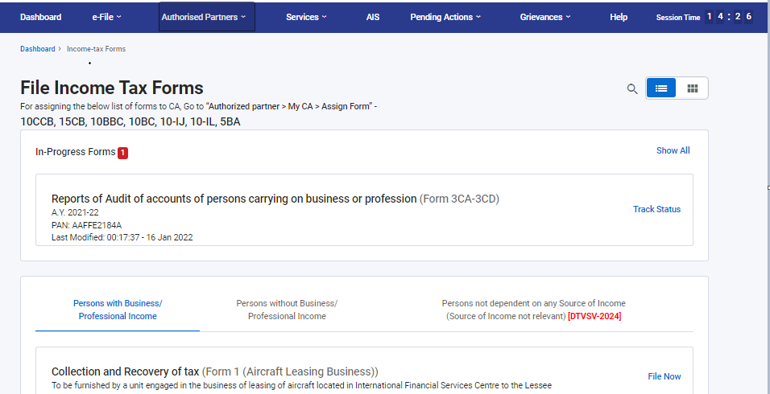

Slide 67
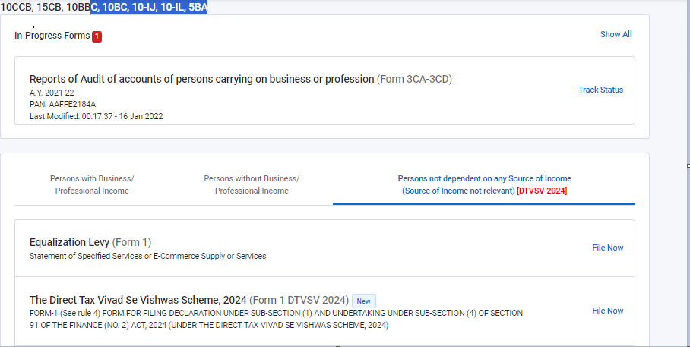

Slide 68
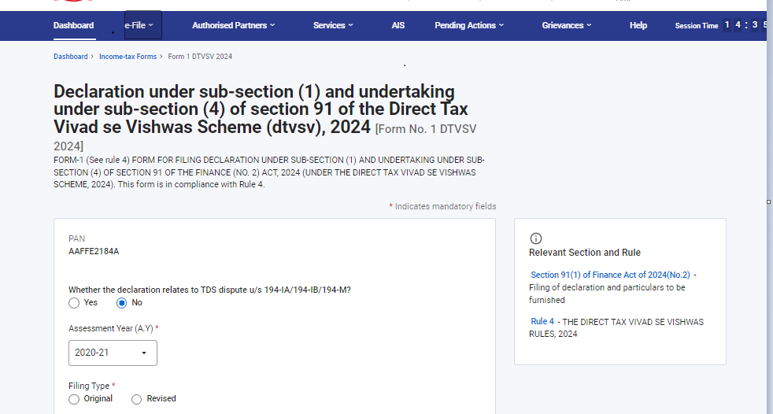

Slide 69
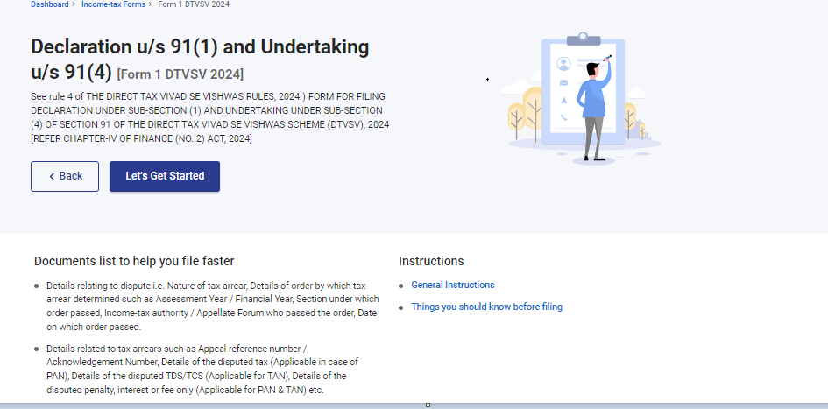

Slide 70
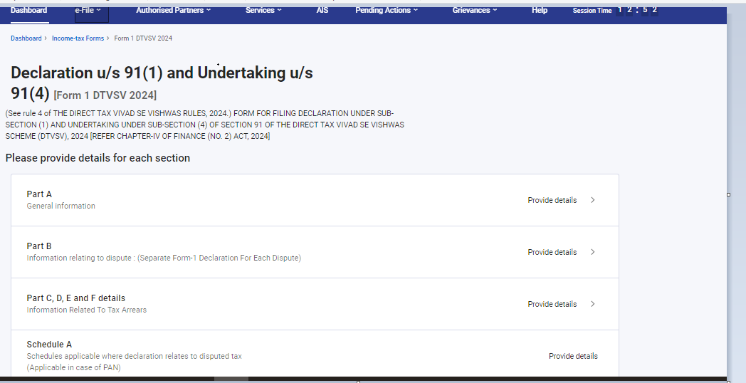

Slide 71
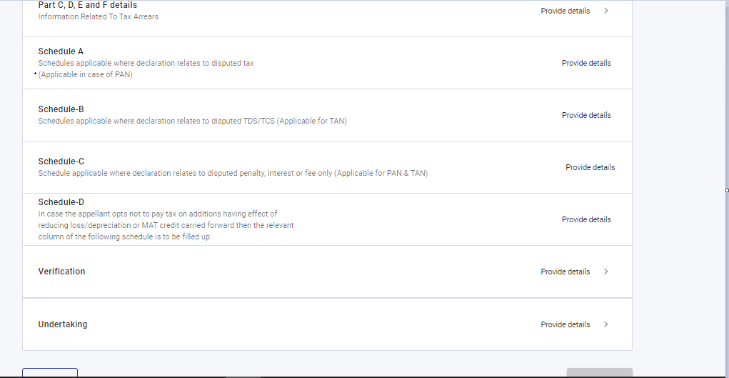

Slide 72
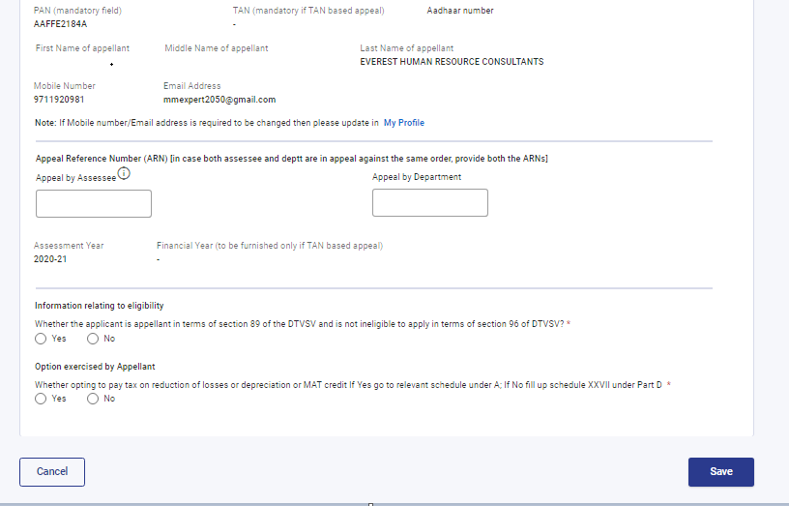

Slide 73
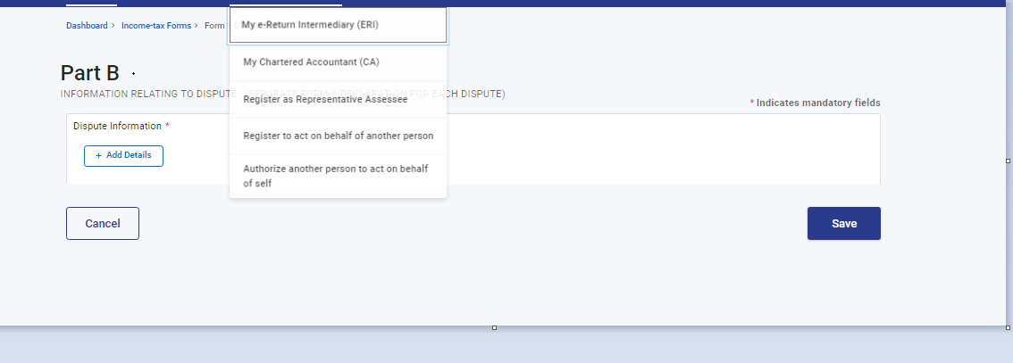

Slide 74
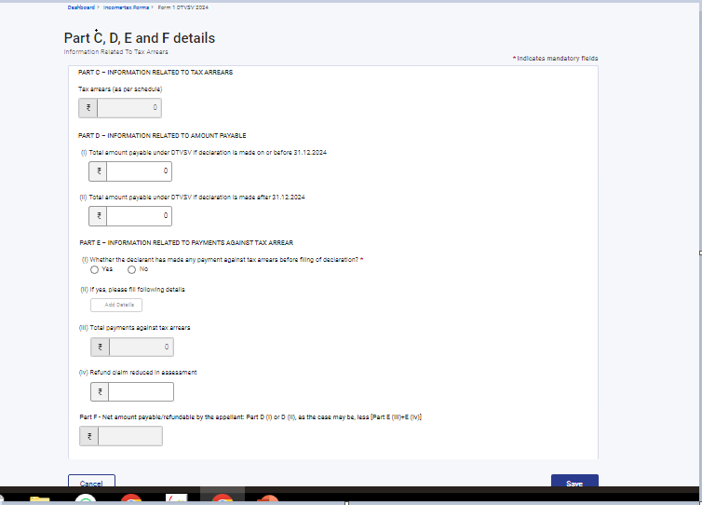

Slide 75
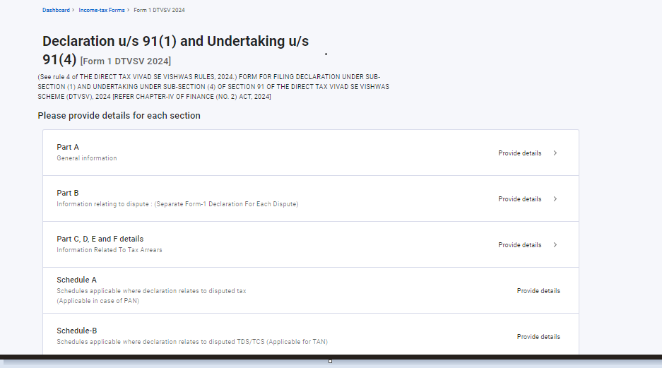

Slide 76
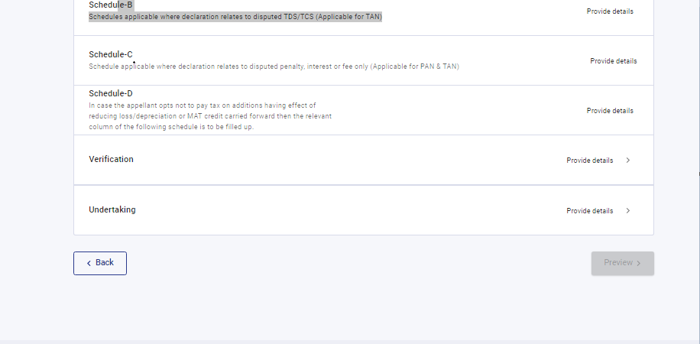

Slide 77
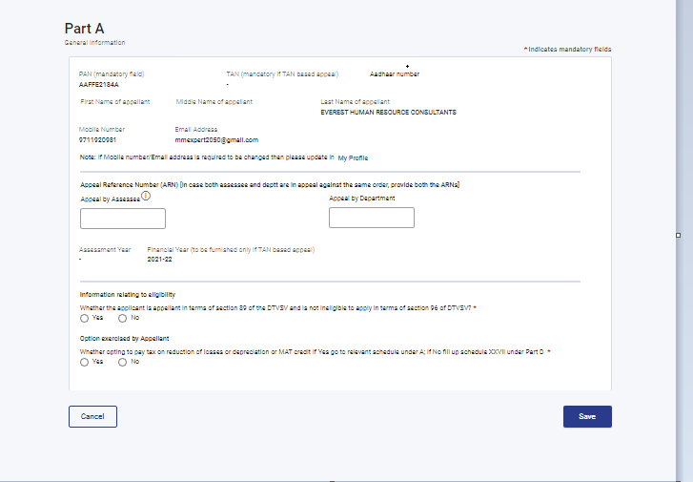

Slide 78
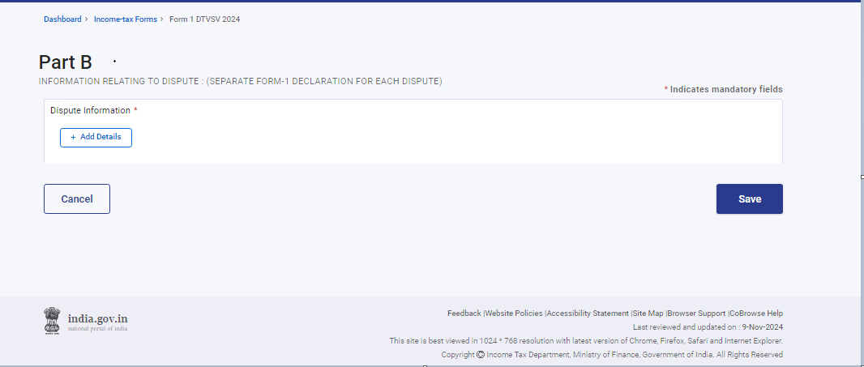

Slide 79

THANK YOU
CA PP SINGH
LLM,LLB,FCA,CS,GSTCC, B.Sc(H)
Contact details 9711521060,9871229590
cappsingh@gmail.com
www.ppsingh.org

